Slide 1

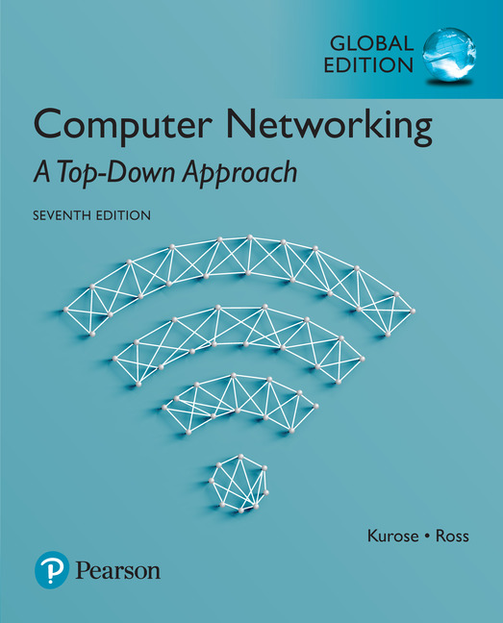

Chapter 1 Introduction
A note on the use of these Powerpoint slides:
We’re making these slides freely available to all (faculty, students, readers). They’re in PowerPoint form so you see the animations; and can add, modify, and delete slides (including this one) and slide content to suit your needs. They obviously represent a lot of work on our part. In return for use, we only ask the following:
Computer Networking: A Top Down Approach
If you use these slides (e.g., in a class) that you mention their source (after all, we’d like people to use our book!)
If you post any slides on a www site, that you note that they are adapted from (or perhaps identical to) our slides, and note our copyright of this material.
Thanks and enjoy! JFK/KWR
All material copyright 1996-2016
J.F Kurose and K.W. Ross, All Rights Reserved
7th Edition, Global Edition Jim Kurose, Keith Ross Pearson April 2016

Slide 2
Chapter 1: introduction
our goal:
get “feel” and terminology
more depth, detail later in course
approach:
use Internet as example
overview:
what’s the Internet?
what’s a protocol?
network edge; hosts, access net, physical media
network core: packet/circuit switching, Internet structure
performance: loss, delay, throughput
security
protocol layers, service models
history

Slide 3
Chapter 1: roadmap
1.1 what is the Internet?
1.2 network edge
end systems, access networks, links
1.3 network core
packet switching, circuit switching, network structure
1.4 delay, loss, throughput in networks
1.5 protocol layers, service models
1.6 networks under attack: security
1.7 history

Slide 4
What Is the Internet?
Internet can be defined in two ways
The basic components – i.e. the nuts and bolt
the basic hardware and software components that make up the Internet
The services it provide
a networking infrastructure that provides services to distributed applications
Internet: the network of networks

Slide 5
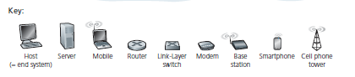
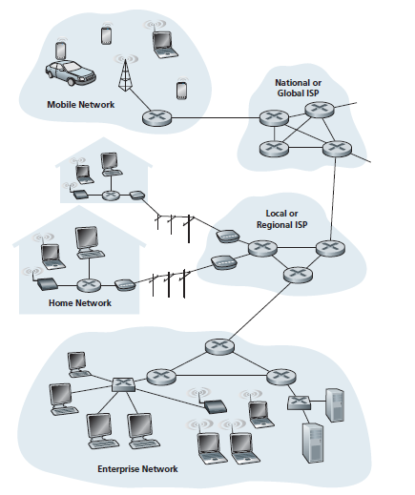
The ‘nuts and bolts’ view
billions of connected computing devices:
hosts = end systems
running network apps
communication links
fiber, copper, radio, satellite
transmission rate: bandwidth
Packet switches: forward packets (chunks of data)
routers and switches
All the pieces of the Internet run protocols that controls the sending and receiving of information
TCP/IP are two of the most important protocols in the Internet.
Notes:
Transmission Control Protocol (TCP) and the Internet Protocol (IP)

Slide 6
The ‘service’ view
These applications include
email, Web surfing, social networks, instant messaging, Voiceover-IP (VoIP), video streaming, distributed games, peer-to-peer (P2P) file sharing, etc
Distributed applications 🡺 involve multiple end systems exchanging data
Have Application Programming Interface (API)
to communicate between different platforms through the Internet
Internet is a network of networks
Interconnected ISPs
Notes:
These applications include email, Web surfing, social networks, instant messaging, Voiceover-IP (VoIP), video streaming, distributed games, peer-to-peer (P2P) file sharing, television over the Internet, remote login, and much, much more.
The applications are said to be distributed applications, since they involve multiple end systems that exchange data with each other

Slide 7




















What’s the Internet: “nuts and bolts” view
PC
billions of connected computing devices:
hosts = end systems
running network apps
mobile network
server
wireless
laptop
global ISP
smartphone
home
network
communication links
fiber, copper, radio, satellite
transmission rate: bandwidth
regional ISP
wireless
links
wired
links
packet switches: forward packets (chunks of data)
routers and switches
router
institutional
network
Notes:
7

Slide 8
What’s the Internet: “nuts and bolts” view
Internet: “network of networks”
Interconnected ISPs
protocols control sending, receiving of messages
e.g., TCP, IP, HTTP, Skype, 802.11
Internet standards
RFC: Request for comments
IETF: Internet Engineering Task Force
mobile network
global ISP
home
network
regional ISP
institutional
network

Slide 9
What’s the Internet: a service view
mobile network
infrastructure that provides services to applications:
Web, VoIP, email, games, e-commerce, social nets, …
provides programming interface to apps
hooks that allow sending and receiving app programs to “connect” to Internet
provides service options, analogous to postal service
global ISP
home
network
regional ISP
institutional
network

Slide 10

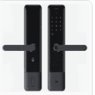

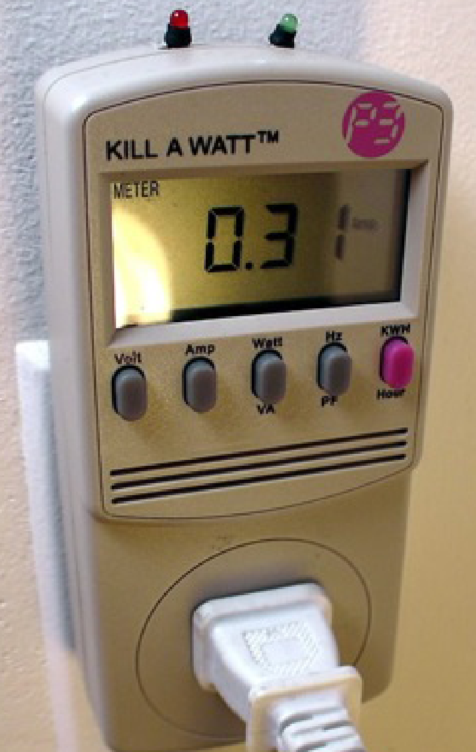




“Fun” Internet-connected devices
Web-enabled toaster +
weather forecaster
Smart Lock
IP picture frame
http://www.ceiva.com/
Tweet-a-watt:
monitor energy use
Slingbox: watch,
control cable TV remotely
sensorized,
bed
mattress
Internet
refrigerator
Internet phones

Slide 11
What’s a protocol?
human protocols:
“what’s the time?”
“I have a question”
introductions
… specific messages sent
… specific actions taken when messages received, or other events
network protocols:
machines rather than humans
all communication activity in Internet governed by protocols
protocols define format, order of messages sent and received among network entities, and actions taken on message transmission, receipt

Slide 12



What’s a protocol?
a human protocol and a computer network protocol:
Hi
TCP connection
request
Hi
TCP connection
response
Got the
time?
Get google.com
2:00
<html>
time
Q: other human protocols?

Slide 13
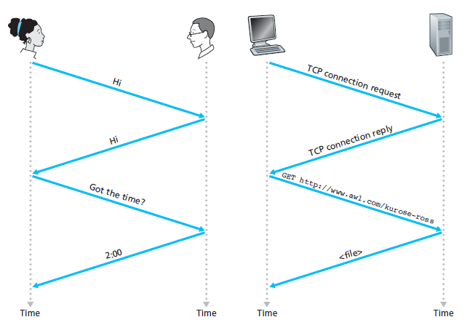
A human protocol
A computer network protocol
Notes:
Introductions
specific message sent
🡪specific actions taken when message received, or other events

Slide 14
Chapter 1: roadmap
1.1 what is the Internet?
1.2 network edge
end systems, access networks, links
1.3 network core
packet switching, circuit switching, network structure
1.4 delay, loss, throughput in networks
1.5 protocol layers, service models
1.6 networks under attack: security
1.7 history
Notes:
14

Slide 15
A closer look at network structure:
network edge:
hosts: clients and servers
servers often in data centers
mobile network
global ISP
access networks, physical media: wired, wireless communication links
home
network
regional ISP
network core:
interconnected routers
network of networks
institutional
network

Slide 16
A closer look
Media: Wired/wireless
Network edge
Access Networks
Network Core

Slide 17
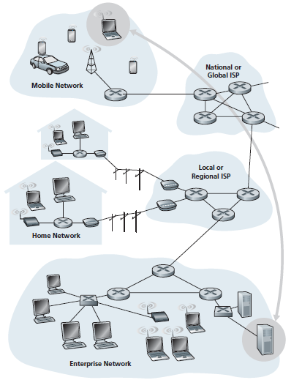
End system interaction

Slide 18
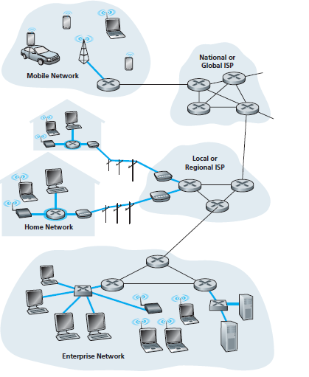
Access networks
The network that physically connects an end system to the first router (also known as the “edge router”) on a path from the end system to any other distant end system.

Slide 19
Access networks and physical media
Q: How to connect end systems to edge router?
residential access nets
institutional access networks (school, company)
mobile access networks
keep in mind:
bandwidth (bits per second) of access network?
shared or dedicated?

Slide 20

Access network: digital subscriber line (DSL)
central office
telephone
network
DSL
modem
splitter
DSLAM
ISP
voice, data transmitted
at different frequencies over
dedicated line to central office
DSL access
multiplexer
use existing telephone line to central office DSLAM
data over DSL phone line goes to Internet
voice over DSL phone line goes to telephone net
< 2.5 Mbps upstream transmission rate (typically < 1 Mbps)
< 24 Mbps downstream transmission rate (typically < 10 Mbps)

Slide 21
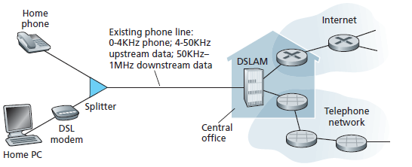

Slide 22
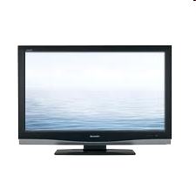


Access network: cable network
cable headend
…
cable
modem
splitter
CMTS
cable modem
termination system
data, TV transmitted at different
frequencies over shared cable
distribution network
ISP
HFC: hybrid fiber coax
asymmetric: up to 30Mbps downstream transmission rate, 2 Mbps upstream transmission rate
network of cable, fiber attaches homes to ISP router
homes share access network to cable headend
unlike DSL, which has dedicated access to central office

Slide 23
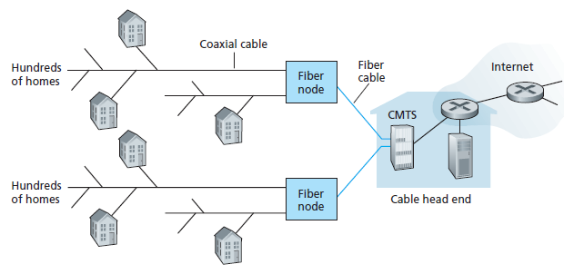

Slide 24
Access network: cable network
cable headend
…
cable
modem
splitter
This is where the splitter is useful – to split between voice (phone) and data (computer)
C
O
N
T
R
O
L
V
I
D
E
O
V
I
D
E
O
V
I
D
E
O
V
I
D
E
O
V
I
D
E
O
V
I
D
E
O
D
A
T
A
D
A
T
A
1
2
3
4
5
6
7
8
9
Channels
frequency division multiplexing: different channels transmitted
in different frequency bands

Slide 25
C
O
N
T
R
O
L
V
I
D
E
O
V
I
D
E
O
V
I
D
E
O
V
I
D
E
O
V
I
D
E
O
V
I
D
E
O
D
A
T
A
D
A
T
A
1
2
3
4
5
6
7
8
9
Channels

Slide 26







Access network: home network
wireless
devices
to/from headend or central office
often combined
in single box
cable or DSL modem
wireless access
point (54 Mbps)
router, firewall, NAT
wired Ethernet (1 Gbps)

Slide 27
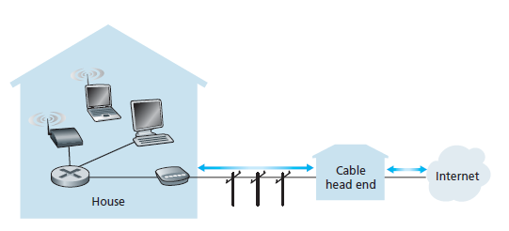

Slide 28









Enterprise access networks (Ethernet)
institutional link to
ISP (Internet)
institutional router
Ethernet
switch
institutional mail,
web servers
typically used in companies, universities, etc.
10 Mbps, 100Mbps, 1Gbps, 10Gbps transmission rates
today, end systems typically connect into Ethernet switch

Slide 29
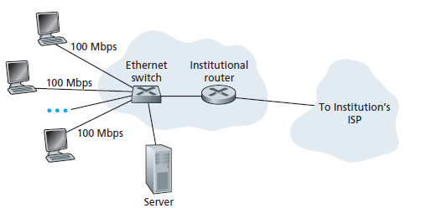

Slide 30


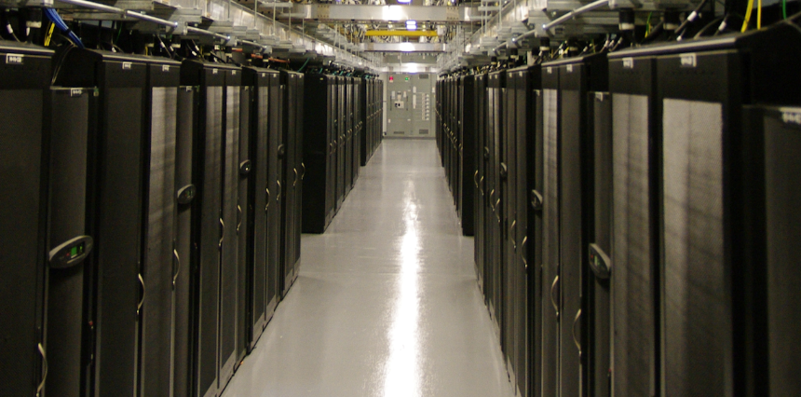


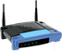



Access networks: data center networks
high-bandwidth links (10s to 100s Gbps) connect hundreds to thousands of servers together, and to Internet
mobile network
national or global ISP
local or regional ISP
home network
content
provider
network
datacenter
network
Courtesy: Massachusetts Green High Performance Computing Center (mghpcc.org)
enterprise
network

Slide 31








Wireless access networks
shared wireless access network connects end system to router
via base station aka “access point”
wide-area wireless access
provided by telco (cellular) operator, 10’s km
between 1 and 10 Mbps
3G, 4G: LTE
wireless LANs:
within building (100 ft.)
802.11b/g/n (WiFi): 11, 54, 450 Mbps transmission rate
to Internet
to Internet

Slide 32


Host: sends packets of data
host sending function:
takes application message
breaks into smaller chunks, known as packets, of length L bits (e.g. 1KB=1024 bit)
transmits packet into access network at transmission rate R
link transmission rate, aka link capacity, aka link bandwidth
two packets,
L bits each
2
1
R: link transmission rate
host
packet
transmission
delay
time needed to
transmit L-bit
packet into link
L (bits)
R (bits/sec)
=
=

Slide 33

Host: sends packets of data
packet
transmission
delay
time needed to
transmit L-bit
packet into link
two packets,
L bits each
=
L (bits)
R (bits/sec)
2
1
=
R: link transmission rate
host
Example: L=30Mbit, R=10Mbps
packet transmission delay
= L/R
= 30Mbit/10Mbps
= 3s

Slide 34
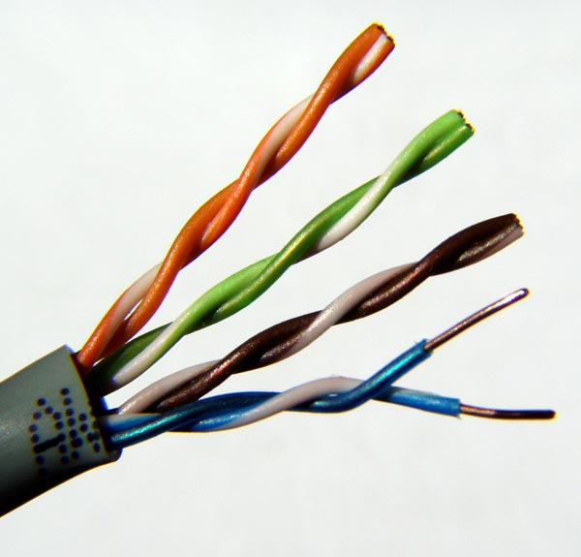
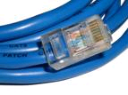
Physical media
bit: propagates between transmitter/receiver pairs
physical link: what lies between transmitter & receiver
guided media:
signals propagate in solid media: copper, fiber, coax
unguided media:
signals propagate freely, e.g., radio
twisted pair (TP)
two insulated copper wires
Category 5: 100 Mbps, 1 Gbps Ethernet
Category 6: 10Gbps

Slide 35
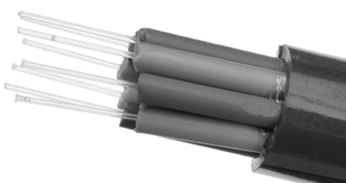

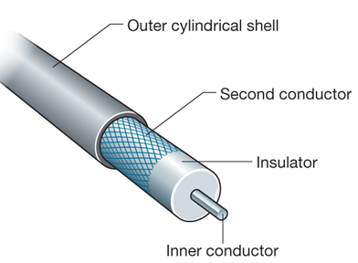

Physical media: coax, fiber
coaxial cable:
two concentric copper conductors
bidirectional
broadband:
multiple channels on cable
HFC
fiber optic cable:
glass fiber carrying light pulses, each pulse a bit
high-speed operation:
high-speed point-to-point transmission (e.g., 10’s-100’s Gbps transmission rate)
low error rate:
repeaters spaced far apart
immune to electromagnetic noise

Slide 36
Physical media: radio
signal carried in electromagnetic spectrum
no physical “wire”
bidirectional
propagation environment effects:
reflection
obstruction by objects
interference
radio link types:
terrestrial microwave
e.g. up to 45 Mbps channels
LAN (e.g., WiFi)
54 Mbps
wide-area (e.g., cellular)
4G cellular: ~ 10 Mbps
satellite
Kbps to 45Mbps channel (or multiple smaller channels)
270 msec end-end delay
geosynchronous versus low altitude

Slide 37
Chapter 1: roadmap
1.1 what is the Internet?
1.2 network edge
end systems, access networks, links
1.3 network core
packet switching, circuit switching, network structure
1.4 delay, loss, throughput in networks
1.5 protocol layers, service models
1.6 networks under attack: security
1.7 history
Notes:
37

Slide 38







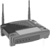

The network core
mesh of interconnected routers
packet-switching: hosts break application-layer messages into packets
forward packets from one router to the next, across links on path from source to destination
each packet transmitted at full link capacity

Slide 39
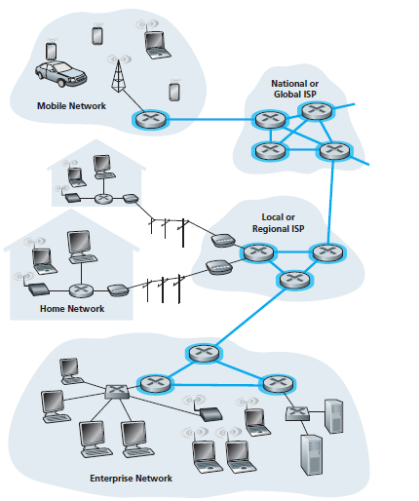
The network core

Slide 40



Packet-switching: store-and-forward
L bits
per packet
source
3
2
1
R bps
R bps
destination
takes L/R seconds to transmit (push out) L-bit packet into link at R bps
store and forward: entire packet must arrive at router before it can be transmitted on next link
one-hop numerical example:
L = 7.5 Mbits
R = 1.5 Mbps
one-hop transmission delay = 5 sec
end-end delay = 2L/R (assuming zero propagation delay)
more on delay shortly …

Slide 41
one-hop numerical example:
L = 7.5 Mbits
R = 1.5 Mbps
one-hop transmission delay = L/R = 5 sec
One-hop numerical example:
L = 10 Kbits
R = 100 Mbps
one-hop transmission delay = 0.1 msec

Slide 42
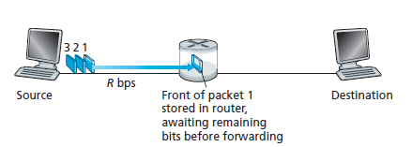
transmitting some of packet 1
the source has three packets, each consisting of L bits, to send to the destination.
When the router has received
all of the packet’s bits can it begin to transmit the packet onto the outbound link.
The router employs store-and-forwarding 🡺 so must first buffer (“store”) the packet’s bits
Notes:
Transmit = forward

Slide 43
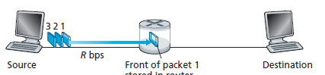
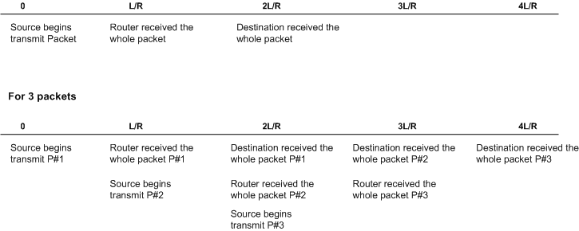
If not store-n-forward:
end-end delay = L/R (assuming no propagation delay)
Router
Time
end-end delay = 2L/R (assuming no propagation delay)
end-end delay = N(L/R)
where
N = the number of links between source and destination

Slide 44
Packet Switching: queueing delay, loss
R = 100 Mb/s
C
A
D
R = 1.5 Mb/s
B
E
queue of packets
waiting for output link
queuing and loss:
if arrival rate (in bits) to link exceeds transmission rate of link for a period of time:
packets will queue, wait to be transmitted on link
packets can be dropped (lost) if memory (buffer) fills up

Slide 45
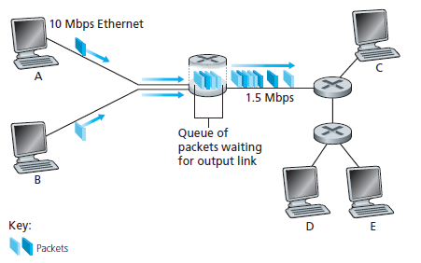
Packet Switching: Queuing Delays and Packet Loss
output buffer /output queue
A and B sends packets to the router
The router forwards packet to destination
When packets arrival at the router exceeds 1.5 Mbps, congestion will occur at the router as packets queue
When packets arrives and queue is full, packet will be dropped 🡺 resulting in packet loss.

Slide 46
Two key network-core functions
routing: determines source-destination route taken by packets
routing algorithms
forwarding: move packets from router’s input to appropriate router output
routing algorithm
local forwarding table
header value
output link
0100
0101
0111
1001
3
2
2
1
1
3
2
0111
destination address in arriving
packet’s header

Slide 47
Two key network-core functions
ROUTING
FORWARDING
determines source to destination route taken by packets
routing algorithms
Global action
move packets from router input interface to appropriate router output interface
Local Action

Slide 48
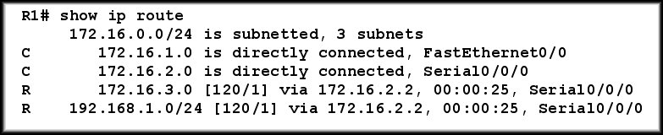
1
3
R1 finds the best path to destination
Router R1 receives a packet
R1 checks the destination address
R1 forwards the packet (or drops it)
2
4
Packet destination: 192.168.1.1

Slide 49
Alternative core: circuit switching
end-end resources allocated to, reserved for “call” between source & dest:
in diagram, each link has four circuits.
call gets 2nd circuit in top link and 1st circuit in right link.
dedicated resources: no sharing
circuit-like (guaranteed) performance
circuit segment idle if not used by call (no sharing)
commonly used in traditional telephone networks

Slide 50
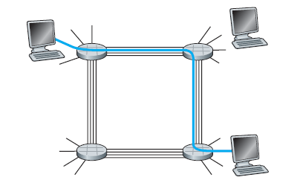
The 4 circuit switches are interconnected by 4 links.
Each of these links has four circuits 🡺 can support 4 simultaneous connections.
Each circuit ¼ of the link’s total transmission capacity for the duration of the connection.
Example:
If a link has a transmission rate of 1 Mbps
🡺 Each connection gets 250 kbps of dedicated transmission rate.

Slide 51
Circuit switching: FDM versus TDM
FDM
Example:
4 users
frequency
time
Users will access media (e.g. cable) based on DIFFERENT frequency (Hz) allocation
TDM
frequency
time
Users will access media (e.g. cable) based on DIFFERENT time slot (second) allocation
Notes:
Two simple multiple access control techniques.
Each mobile’s share of the bandwidth is divided into portions for the uplink and the downlink. Also, possibly, out of band signaling.
As we will see, used in AMPS, GSM, IS-54/136

Slide 52
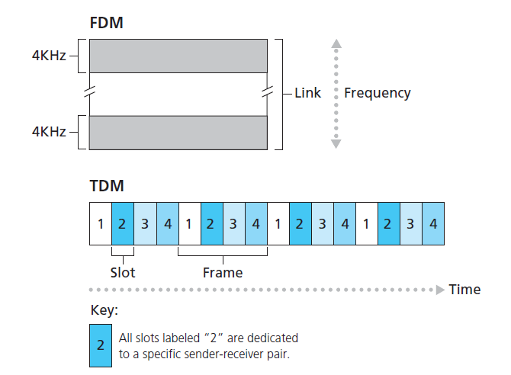
With FDM, each circuit continuously gets a fraction of the bandwidth.
With TDM, each circuit gets all of the bandwidth
periodically during brief intervals of time (that is, during slots)

Slide 53
Packet switching versus circuit switching
packet switching allows more users to use network!
example:
1 Mb/s link
each user:
100 kb/s when “active”
active 10% of time
circuit-switching:
10 users
packet switching:
with 35 users, probability > 10 active at same time is less than .0004 *
N
users
…..
1 Mbps link
Q: how did we get value 0.0004?
Q: what happens if > 35 users ?
Notes:
* Check out the online interactive exercises for more examples: http://gaia.cs.umass.edu/kurose_ross/interactive/

Slide 54
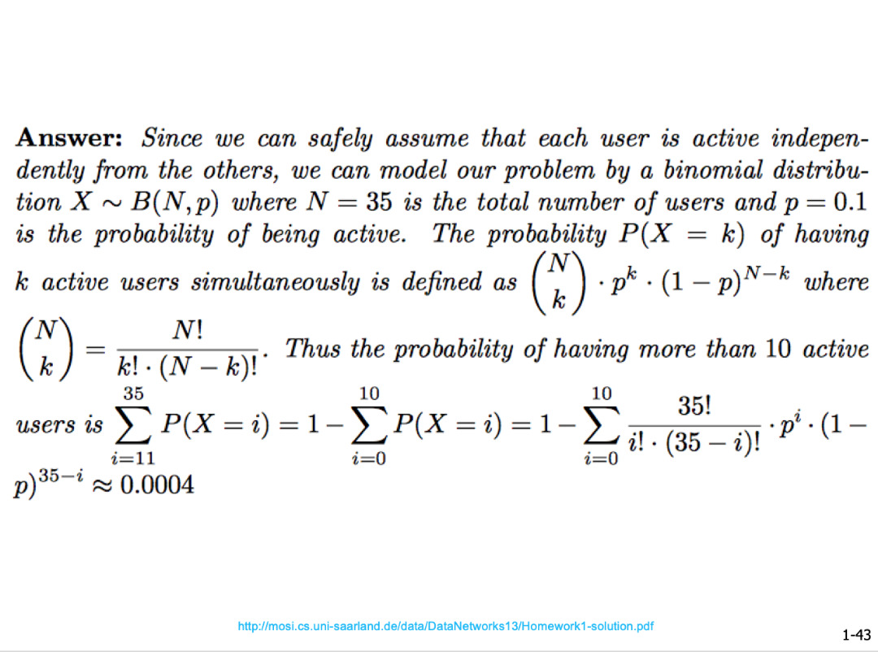
Not part of your syllabus – just extra knowledge

Slide 55
Packet switching versus circuit switching
is packet switching a “slam dunk winner?”
great for bursty data
resource sharing
simpler, no call setup
excessive congestion possible: packet delay and loss
protocols needed for reliable data transfer, congestion control
Q: How to provide circuit-like behavior?
bandwidth guarantees needed for audio/video apps
still an unsolved problem (chapter 7)
Q: human analogies of reserved resources (circuit switching) versus on-demand allocation (packet-switching)?

Slide 56
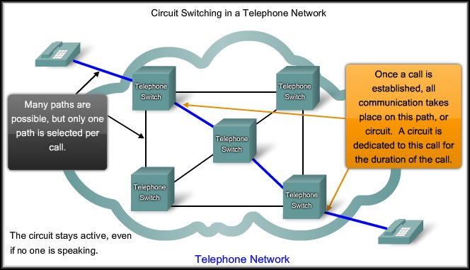
Circuit Switched – Connection-Oriented Networks

Slide 57
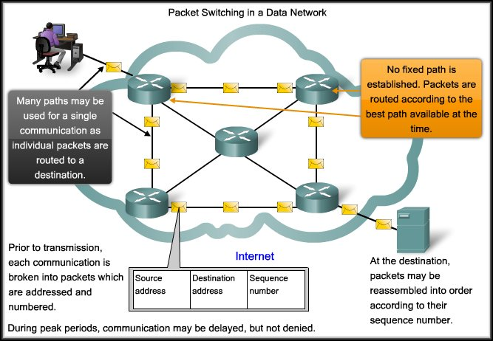
Packet Switched – Connectionless Networks

Slide 58
Circuit Switched | Packet Switched
Connection-oriented | Connectionless
Dedicated Circuit | Shared Circuit
Guaranteed level of service (Bandwidth, QoS) | Messages divided into packets
Inefficient use of Medium | Efficient use of Medium
Single path, no redundancy | Fault Tolerant, multiple possible paths

Slide 59
Internet structure: network of networks
End systems connect to Internet via access ISPs (Internet Service Providers)
residential, company and university ISPs
Access ISPs in turn must be interconnected.
so that any two hosts can send packets to each other
Resulting network of networks is very complex
evolution was driven by economics and national policies
Let’s take a stepwise approach to describe current Internet structure

Slide 60
Internet structure: network of networks
Question: given millions of access ISPs, how to connect them together?
…
…
access
net
access
net
access
net
access
net
access
net
access
net
access
net
…
…
access
net
access
net
access
net
access
net
access
net
access
net
…
access
net
access
net
…
access
net

Slide 61
Internet structure: network of networks
Option: connect each access ISP to every other access ISP?
…
…
access
net
access
net
access
net
access
net
access
net
…
…
access
net
access
net
…
connecting each access ISP to each other directly doesn’t scale: O(N²) connections.
…
…
access
net
access
net
…
access
net
access
net
access
net
…
access
net
…
access
net
access
net
…
access
net

Slide 62
Internet structure: network of networks
Option: connect each access ISP to one global transit ISP?
Customer and provider ISPs have economic agreement.
…
…
access
net
access
net
access
net
access
net
access
net
access
net
access
net
…
…
global ISP
access
net
access
net
access
net
access
net
access
net
access
net
…
access
net
access
net
…
access
net

Slide 63
Internet structure: network of networks
But if one global ISP is viable business, there will be competitors ….
…
…
access
net
access
net
access
net
access
net
access
net
access
net
ISP A
access
net
…
…
access
net
ISP B
access
net
ISP C
access
net
access
net
access
net
access
net
…
access
net
access
net
…
access
net

Slide 64
Internet structure: network of networks
But if one global ISP is viable business, there will be competitors …. which must be interconnected
Internet exchange point
…
…
access
net
access
net
access
net
access
net
access
net
IXP
access
net
access
net
ISP A
…
…
access
net
IXP
ISP B
access
net
ISP C
access
net
access
net
peering link
access
net
access
net
…
access
net
access
net
…
access
net

Slide 65
Internet structure: network of networks
… and regional networks may arise to connect access nets to ISPs
…
…
access
net
access
net
access
net
access
net
access
net
IXP
access
net
access
net
ISP A
…
…
access
net
IXP
ISP B
access
net
ISP C
access
net
access
net
access
net
regional net
access
net
…
access
net
access
net
…
access
net

Slide 66
Internet structure: network of networks
… and content provider networks (e.g., Google, Microsoft, Akamai) may run their own network, to bring services, content close to end users
…
…
access
net
access
net
access
net
access
net
access
net
IXP
access
net
access
net
ISP A
…
…
Content provider network
access
net
IXP
ISP B
access
net
ISP C
access
net
access
net
access
net
regional net
access
net
…
access
net
access
net
…
access
net

Slide 67
Internet structure: network of networks
Tier 1 ISP
Tier 1 ISP
Google
IXP
IXP
IXP
Regional ISP
Regional ISP
access
ISP
access
ISP
access
ISP
access
ISP
access
ISP
access
ISP
access
ISP
access
ISP
at center: small number of well-connected large networks
“tier-1” commercial ISPs (e.g., Level 3, Sprint, AT&T, NTT), national & international coverage
content provider network (e.g., Google): private network that connects it data centers to Internet, often bypassing tier-1, regional ISPs
Example ISP list in Malaysia: List , Service Offer , Service Cost

Slide 68
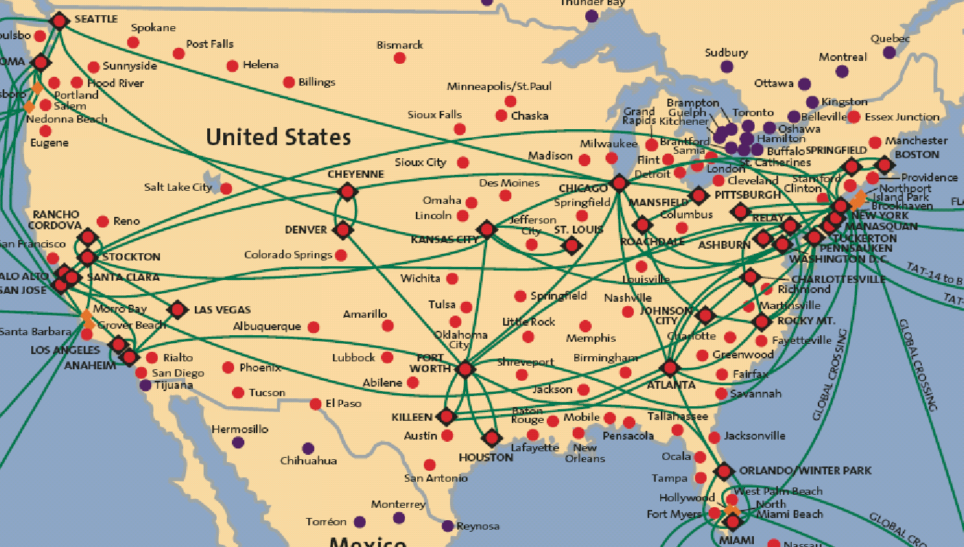
Tier-1 ISP: e.g., Sprint
POP: point-of-presence
to/from backbone
peering
…
…
…
…
…
to/from customers

Slide 69
Chapter 1: roadmap
1.1 what is the Internet?
1.2 network edge
end systems, access networks, links
1.3 network core
packet switching, circuit switching, network structure
1.4 delay, loss, throughput in networks
1.5 protocol layers, service models
1.6 networks under attack: security
1.7 history
Notes:
69

Slide 70
How do loss and delay occur?
packets queue in router buffers
packet arrival rate to link (temporarily) exceeds output link capacity
packets queue, wait for turn
packet being transmitted (delay)
A
B
packets queueing (delay)
free (available) buffers: arriving packets
dropped (loss) if no free buffers

Slide 71
How do loss and delay occur?
packets queuing (delay)
packet being transmitted (delay)
Queue is full, packet dropped (loss)

Slide 72
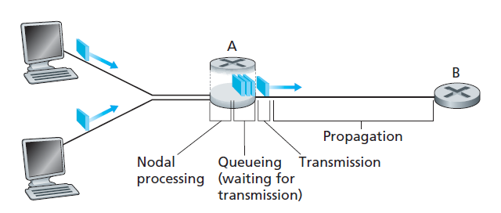
The nodal delay at router A
A packet goes through a series of delays at each node along the path
d_{prop}
d_{trans}
d_{proc}
d_{queue}
Total nodal delay = d_{nodal} = d_{proc} + d_{queue} + d_{trans} + d_{prop}
Notes:
Total nodal delay = nodal processing delay + queuing delay + transmission Delay + propagation delay

Slide 73
Four sources of packet delay
transmission
A
propagation
B
nodal
processing
queueing
d_{nodal} = d_{proc} + d_{queue} + d_{trans} + d_{prop}
d_{proc}: nodal processing
check bit errors
determine output link
typically < msec
d_{queue}: queueing delay
time waiting at output link for transmission
depends on congestion level of router

Slide 74
Four sources of packet delay
transmission
A
propagation
B
nodal
processing
queueing
d_{nodal} = d_{proc} + d_{queue} + d_{trans} + d_{prop}
d_{trans}: transmission delay:
L: packet length (bits)
R: link bandwidth (bps)
d_{trans} = L/R
d_{prop}: propagation delay:
d: length of physical link
s: propagation speed (~2x10⁸ m/sec)
d_{prop} = d/s
d_{trans} and d_{prop}
very different
Notes:
74
* Check out the online interactive exercises for more examples: http://gaia.cs.umass.edu/kurose_ross/interactive/
* Check out the Java applet for an interactive animation on trans vs. prop delay

Slide 75
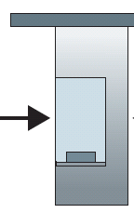

Caravan analogy
100 km
100 km
ten-car
caravan
toll
booth
toll
booth
cars “propagate” at 100 km/hr
toll booth takes 12 sec to service car (bit transmission time)
car ~ bit; caravan ~ packet
Q: How long until caravan is lined up before 2nd toll booth?
time to “push” entire caravan through toll booth onto highway = 12*10 = 120 sec
time for last car to propagate from 1st to 2nd toll both: 100km/(100km/hr)= 1 hr
A: 62 minutes

Slide 76
Caravan analogy (more)
100 km
100 km
ten-car
caravan
toll
booth
toll
booth
suppose cars now “propagate” at 1000 km/hr
and suppose toll booth now takes one (1) min to service a car
Q: Will cars arrive to 2nd booth before all cars serviced at first booth?
A: Yes! after 7 min, first car arrives at second booth; three cars still at first booth

Slide 77
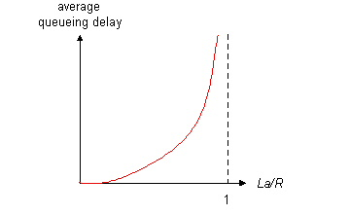

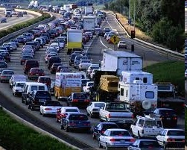
Queueing delay (revisited)
R: link bandwidth (bps)
L: packet length (bits)
a: average packet arrival rate
average queueing delay
traffic intensity
= La/R
La/R ~ 0: avg. queueing delay small
La/R -> 1: avg. queueing delay large
La/R > 1: more “work” arriving
than can be serviced, average delay infinite!
La/R ~ 0
La/R -> 1

Slide 78
“Real” Internet delays and routes
what do “real” Internet delay & loss look like?
traceroute/tracert program: provides delay measurement from source to router along end-end Internet path towards destination. For all i:
sends three packets that will reach router i on path towards destination
router i will return packets to sender
sender times interval between transmission and reply.
3 probes
3 probes
3 probes

Slide 79
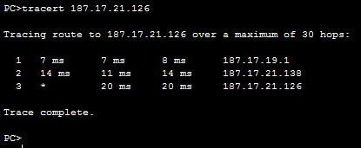
the destination system
The IP address of the hop
Hop number: The specific hop number in the path from the sender to the destination.
Round Trip Time (RTT):
The time it takes for a packet to get to a hop and back, displayed in milliseconds (ms).
🡺 By default, tracert sends 3 packets to each hop, so the output lists three roundtrip times per hop.

Slide 80
“Real” Internet delays, routes
traceroute: gaia.cs.umass.edu to www.eurecom.fr
3 delay measurements from
gaia.cs.umass.edu to cs-gw.cs.umass.edu
1 cs-gw (128.119.240.254) 1 ms 1 ms 2 ms
2 border1-rt-fa5-1-0.gw.umass.edu (128.119.3.145) 1 ms 1 ms 2 ms
3 cht-vbns.gw.umass.edu (128.119.3.130) 6 ms 5 ms 5 ms
4 jn1-at1-0-0-19.wor.vbns.net (204.147.132.129) 16 ms 11 ms 13 ms
5 jn1-so7-0-0-0.wae.vbns.net (204.147.136.136) 21 ms 18 ms 18 ms
6 abilene-vbns.abilene.ucaid.edu (198.32.11.9) 22 ms 18 ms 22 ms
7 nycm-wash.abilene.ucaid.edu (198.32.8.46) 22 ms 22 ms 22 ms
8 62.40.103.253 (62.40.103.253) 104 ms 109 ms 106 ms
9 de2-1.de1.de.geant.net (62.40.96.129) 109 ms 102 ms 104 ms
10 de.fr1.fr.geant.net (62.40.96.50) 113 ms 121 ms 114 ms
11 renater-gw.fr1.fr.geant.net (62.40.103.54) 112 ms 114 ms 112 ms
12 nio-n2.cssi.renater.fr (193.51.206.13) 111 ms 114 ms 116 ms
13 nice.cssi.renater.fr (195.220.98.102) 123 ms 125 ms 124 ms
14 r3t2-nice.cssi.renater.fr (195.220.98.110) 126 ms 126 ms 124 ms
15 eurecom-valbonne.r3t2.ft.net (193.48.50.54) 135 ms 128 ms 133 ms
16 194.214.211.25 (194.214.211.25) 126 ms 128 ms 126 ms
17 * * *
18 * * *
19 fantasia.eurecom.fr (193.55.113.142) 132 ms 128 ms 136 ms
trans-oceanic
link
* means no response (probe lost, router not replying)
* Do some traceroutes from exotic countries at www.traceroute.org

Slide 81
Packet loss
queue (aka buffer) preceding link in buffer has finite capacity
packet arriving to full queue dropped (aka lost)
lost packet may be retransmitted by previous node, by source end system, or not at all
buffer
(waiting area)
A
packet being transmitted
B
packet arriving to
full buffer is lost
Notes:
* Check out the Java applet for an interactive animation on queuing and loss

Slide 82
Throughput
throughput: rate (bits/time unit) at which bits transferred between sender/receiver
instantaneous: rate at given point in time
average: rate over longer period of time
R_{s} bits/sec
R_{C} bits/sec
server sends bits
(fluid) into pipe
pipe that can carry
fluid at rate
R_{s} bits/sec)
pipe that can carry
fluid at rate
R_{c} bits/sec)

Slide 83
Throughput (more)
R_{s} < R_{c} What is average end-end throughput?
R_{s} bits/sec
R_{c} bits/sec
R_{s} > R_{c} What is average end-end throughput?
R_{s} bits/sec
R_{c} bits/sec
bottleneck link
link on end-end path that constrains end-end throughput

Slide 84
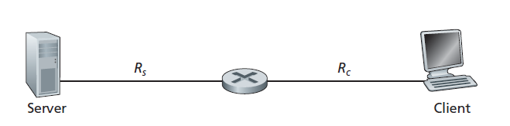
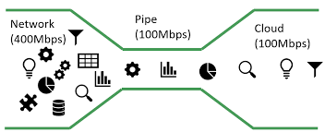
If R_{s} < R_{c}
Flow from Server to Client not interrupted
Throughput = R_{s}
If R_{s} > R_{c}
Flow from Server to Client is interrupted, queue may form
Throughput = R_{c}
Throughput = min{Rc, Rs},
🡺 the transmission rate of the bottleneck link
Notes:
Tip:
In bottleneck link,
Throughput = the rate of the link on the end-to-end path that constrains end-to-end throughput 🡺 whichever is smaller

Slide 85
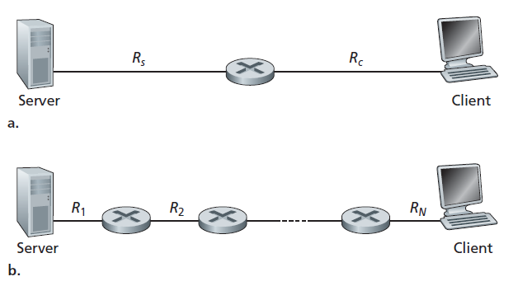
Throughput for a file transfer from server to client
Throughput = min{Rc, Rs},
Throughput = min{R1, R2,..., RN},

Slide 86
Example A
The time it takes to transfer a large file of F bits from server to client as F/min{Rs, Rc}
Say, you are downloading a file of F = 32 million bits, the server has a transmission rate of Rs = 2 Mbps, and you have an access link of Rc = 1 Mbps.
The time needed to transfer the file is
Transfer time = (32 x 10⁶) bits/1Mbps
= 32 seconds
Notes:
Of course, these expressions for throughput and transfer time are
only approximations, as they do not account for store-and-forward and processing delays as well as protocol issues.

Slide 87
Throughput: Internet scenario
per-connection end-end throughput: min(R_{c},R_{s},R/10)
in practice: R_{c} or R_{s} is often bottleneck
R_{s}
R_{s}
R_{s}
R
R_{c}
R_{c}
R_{c}
10 connections (fairly) share backbone bottleneck link R bits/sec
Notes:
* Check out the online interactive exercises for more examples: http://gaia.cs.umass.edu/kurose_ross/interactive/

Slide 88
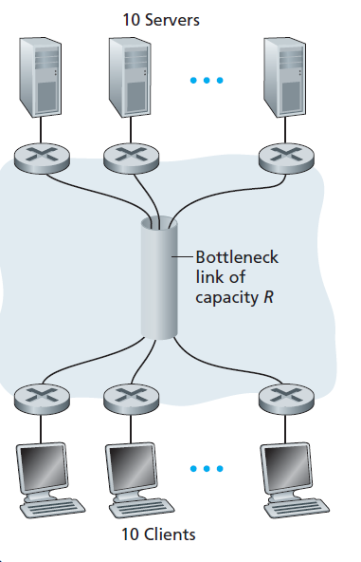
End-to-end throughput: Internet scenario
Example B:
If R_{s} = 2Mbps, R_{c} = 1Mbps, R = 5Mbps, what is the throughput?
Answer:
Because R is shared, what is available for each link is (5Mbps/10) = 500kbps
Throughput = 500kbps

Slide 89
Calculation: Example 1
Suppose Host A wants to send a large file to Host B. The path from Host A to Host B has 3-links, of rate R₁=150kbps, R₂=2Mbps, and R₃=1Mbps.
i) Assuming no other traffic in the network, what is the throughput for the file transfer? Justify your answer. [2 mark]
Throughput = min(R)=150 kbps
ii) Suppose the file is 4 million bytes. Roughly, how long will it take to transfer the file to Host B? [5 marks]
Time transfer=4*10⁶*8/(150*10³)=213.3 seconds

Slide 90
Calculation: Example 2
Host A wants to send a 30-Mbit MP3 file to host B. All the links in the path between source and destination have a transmission rate of 10Mbps. Assume that the propagation speed is 2*10⁸ meters/sec, and the distance between source and destination is 10km. Initially suppose there is only one link between the source and the destination. Also suppose that the entire MP3 file is sent as one packet (Ignore processing delay and queuing delay). Show your workings.
i) Calculate the transmission delay?
transmission delay = L/R = 30M/10Mbps = 3s
ii) What will be the end-to-end delay?
D_{prop} = d/s = 10000/2*10⁸ = 0.00005s
D_{total} = 3+0.00005 = 3. 00005s
iii) How many bits will the source have transmitted when the first bit of the MP3 file arrives at the destination?
R* D_{prop} = 10Mbps*0.00005s=500bit

Slide 91
Chapter 1: roadmap
1.1 what is the Internet?
1.2 network edge
end systems, access networks, links
1.3 network core
packet switching, circuit switching, network structure
1.4 delay, loss, throughput in networks
1.5 protocol layers, service models
1.6 networks under attack: security
1.7 history
Notes:
91

Slide 92
Protocol “layers”
Networks are complex,
with many “pieces”:
hosts
routers
links of various media
applications
protocols
hardware, software
Question:
is there any hope of organizing structure of network?
…. or at least our discussion of networks?

Slide 93
Organization of air travel
ticket (purchase)
baggage (check)
gates (load)
runway takeoff
airplane routing
ticket (complain)
baggage (claim)
gates (unload)
runway landing
airplane routing
airplane routing
a series of steps

Slide 94

Layering of airline functionality
ticket (purchase)
baggage (check)
gates (load)
runway (takeoff)
airplane routing
ticket (complain)
baggage (claim
gates (unload)
runway (land)
airplane routing
ticket
baggage
gate
takeoff/landing
airplane routing
airplane routing
airplane routing
departure
airport
intermediate air-traffic
control centers
arrival
airport
layers: each layer implements a service
via its own internal-layer actions
relying on services provided by layer below

Slide 95
Why layering?
dealing with complex systems:
explicit structure allows identification, relationship of complex system’s pieces
layered reference model for discussion
modularization eases maintenance, updating of system
change of implementation of layer’s service transparent to rest of system
e.g., change in gate procedure doesn’t affect rest of system
layering considered harmful?

Slide 96
ISO/OSI reference model
Open System Interconnection (OSI) model defines a generic networking framework to implement protocols in seven (7) layers
Generic OSI Model
 | Data unit | Layer | Function
Host layers | Data | 7. Application | Network process to application
 |  | 6. Presentation | allow applications to interpret meaning of data, e.g. data representation, encryption and decryption, convert machine dependent data to machine independent data
 |  | 5. Session | Interhost communication, managing sessions between applications, synchronization, data recovery
 | Segments | 4. Transport | Reliable delivery of packets between points on a network.
Media layers | Packet/Datagram | 3. Network | Addressing, routing and (not necessarily reliable) delivery of datagrams between points on a network.
 | Bit/Frame | 2. Data link | A reliable direct point-to-point data connection.
 | Bit | 1. Physical | A (not necessarily reliable) direct point-to-point data connection.

Slide 97

OSI Model: AN Analogy: Application Layer - Source Host
After riding your new bicycle a few times in Tokyo, you decide that you want to give it to a friend who studies in UTM, JB.

Slide 98


Presentation & Session Layer - Source Host
PRESENTATION:
Make sure you have the proper directions to disassemble and reassemble the bicycle.
SESSION:
Call your friend and make sure you have his correct address.

Slide 99

OSI Model Analogy :Transport Layer - Source Host
Disassemble the bicycle and put different pieces in different boxes. The boxes are labeled
“1 of 3”, “2 of 3”, and “3 of 3”.

Slide 100

OSI Model Analogy: Network Layer - Source Host
Put your friend's complete mailing address (and yours) on each box. Since the packages are too big for your mailbox (and since you don’t have enough stamps) you determine that you need to go to the post office.

Slide 101


OSI Model Analogy: Data Link Layer – Source Host
Tokyo post office takes possession of the boxes.

Slide 102

OSI Model Analogy: Physical Layer - Media
The boxes are flown from Tokyo to JB

Slide 103

OSI Model Analogy : Data Link Layer - Destination
UTM post office receives your boxes.

Slide 104
OSI Model Analogy: Network Layer - Destination
Upon examining the destination address, UTM post office determines that your boxes should be delivered to the written home address.

Slide 105

OSI Model Analogy : Transport Layer - Destination
Your friend calls you and tells you he got all 3 boxes and he is having another friend named FARIS reassemble the bicycle.

Slide 106


Session & Presentation Layer - Destination
PRESENTATION:
FARIS is finished and “presents” the bicycle to your friend. Another way to say it is that your friend is finally getting his “present”.
SESSION:
Your friend hangs up because he is done talking to you.

Slide 107
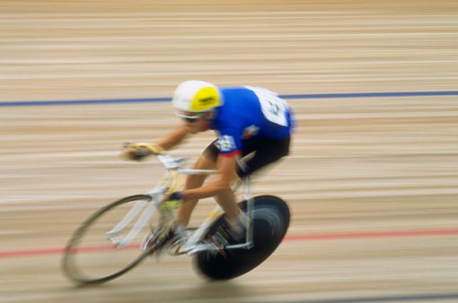
OSI Model Analogy : Application Layer - Destination
Your friend enjoys riding his new bicycle in UTM.

Slide 108
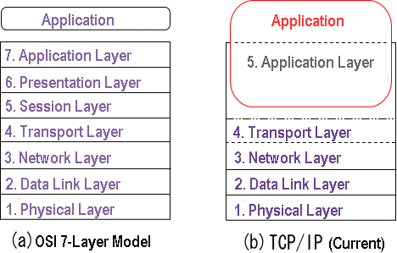
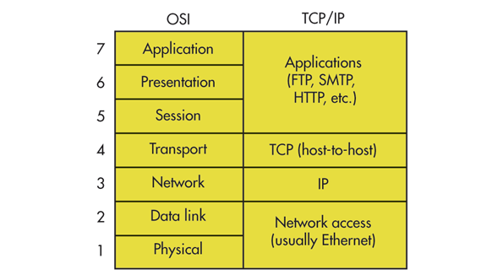
Internet protocol stack (TCP/IP model)
TCP/IP was developed by Advanced Research Projects Agency (ARPA) to build a nationwide packet data network in 1960s. It was first used in UNIX-based computers in universities and government installations. Today, it is the main protocol used in all Internet operations.
Notes:
1960s – TCPIP
1970s – OSI

Slide 109
Internet protocol stack
application: supporting network applications
FTP, SMTP, HTTP
transport: process-process data transfer
TCP, UDP
network: routing of datagrams from source to destination
IP, routing protocols
link: data transfer between neighboring network elements
Ethernet, 802.111 (WiFi), PPP
physical: bits “on the wire”
application
transport
network
link
physical

Slide 110
ISO/OSI reference model
presentation: allow applications to interpret meaning of data, e.g., encryption, compression, machine-specific conventions
session: synchronization, checkpointing, recovery of data exchange
Internet stack “missing” these layers!
these services, if needed, must be implemented in application
needed?
application
presentation
session
transport
network
link
physical

Slide 111
Encapsulation
source
message
M
application
transport
network
link
physical
segment
H_{t}
M
H_{t}
datagram
H_{n}
H_{n}
H_{t}
M
frame
H_{l}
H_{n}
H_{t}
M
link
physical
switch
destination
H_{n}
H_{t}
M
network
link
physical
M
application
transport
network
link
physical
H_{l}
H_{n}
H_{t}
M
H_{n}
H_{t}
M
H_{t}
M
H_{n}
H_{t}
M
H_{l}
H_{n}
H_{t}
M
router

Slide 112
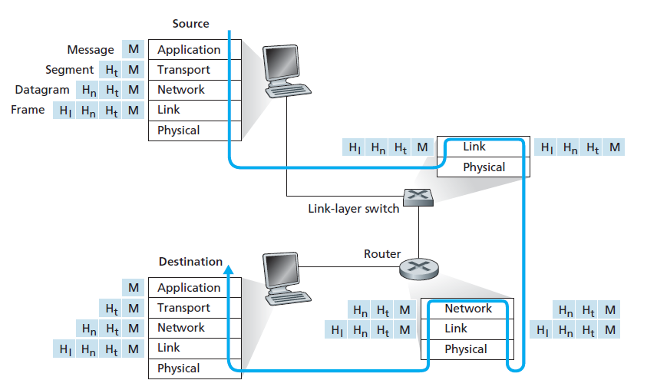
Encapsulation

Slide 113
Chapter 1: roadmap
1.1 what is the Internet?
1.2 network edge
end systems, access networks, links
1.3 network core
packet switching, circuit switching, network structure
1.4 delay, loss, throughput in networks
1.5 protocol layers, service models
1.6 networks under attack: security
1.7 history
Notes:
113

Slide 114
Network security
field of network security:
how bad guys can attack computer networks
how we can defend networks against attacks
how to design architectures that are immune to attacks
Internet not originally designed with (much) security in mind
original vision: “a group of mutually trusting users attached to a transparent network” ☺
Internet protocol designers playing “catch-up”
security considerations in all layers!

Slide 115
Bad guys: put malware into hosts via Internet
malware can get in host from:
virus: self-replicating infection by receiving/executing object (e.g., e-mail attachment)
worm: self-replicating infection by passively receiving object that gets itself executed
spyware malware can record keystrokes, web sites visited, upload info to collection site
infected host can be enrolled in botnet, used for spam, DDoS attacks

Slide 116
Bad guys: put malware into hosts via Internet
Malware = malicious software
Examples: Worm, Virus, Trojans, spyware, botnet, etc.
Malware can be
Self-replicating 🡺 once it infects one host, from that host it seeks entry into other hosts over the Internet, and just keep going
User activated (click on an email attachment) or
Program activated (a vulnerable app that activates malware)
Recruiting your device to be part of a botnet, to be use for any purpose later

Slide 117

Bad guys: attack server, network infrastructure
Denial of Service (DoS): attackers make resources (server, bandwidth) unavailable to legitimate traffic by overwhelming resource with bogus traffic
1. select target
2. break into hosts around the network (see botnet)
3. send packets to target from compromised hosts
target

Slide 118
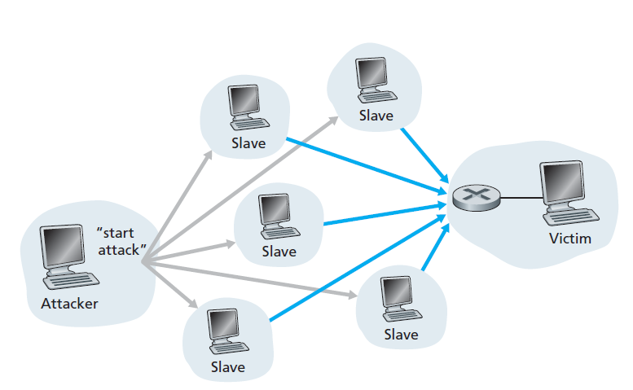
Denial of Service (DoS):

Slide 119
Bad guys can sniff packets
packet “sniffing”:
broadcast media (shared Ethernet, wireless)
promiscuous network interface reads/records all packets (e.g., including passwords!) passing by
A
C
src:B dest:A payload
B
wireshark software used for end-of-chapter labs is a (free) packet-sniffer

Slide 120
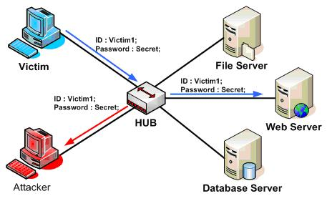
Packet “sniffing”:

Slide 121
Bad guys can use fake addresses
IP spoofing: send packet with false source address
A
C
src:B dest:A payload
B

Slide 122
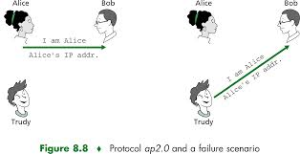
IP spoofing:

Slide 123
Chapter 1: roadmap
1.1 what is the Internet?
1.2 network edge
end systems, access networks, links
1.3 network core
packet switching, circuit switching, network structure
1.4 delay, loss, throughput in networks
1.5 protocol layers, service models
1.6 networks under attack: security
1.7 history
Notes:
123

Slide 124
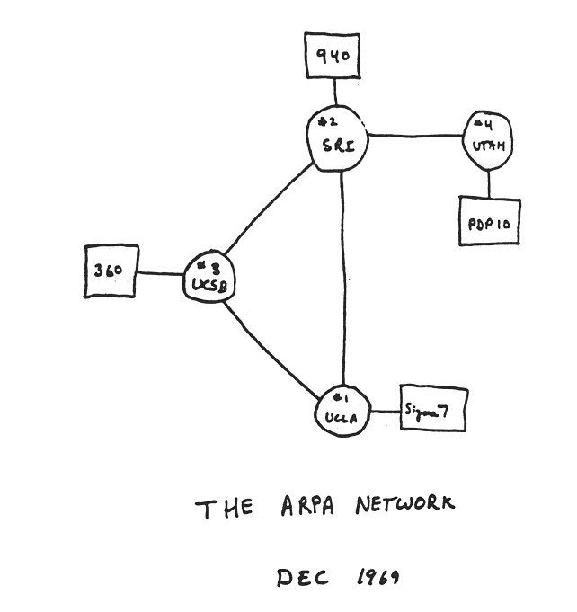
Internet history
1961-1972: Early packet-switching principles
1961: Kleinrock - queueing theory shows effectiveness of packet-switching
1964: Baran - packet-switching in military nets
1967: ARPAnet conceived by Advanced Research Projects Agency
1969: first ARPAnet node operational
1972:
ARPAnet public demo
NCP (Network Control Protocol) first host-host protocol
first e-mail program
ARPAnet has 15 nodes

Slide 125
Internet history
1972-1980: Internetworking, new and proprietary nets
1970: ALOHAnet satellite network in Hawaii
1974: Cerf and Kahn - architecture for interconnecting networks
1976: Ethernet at Xerox PARC
late70’s: proprietary architectures: DECnet, SNA, XNA
late 70’s: switching fixed length packets (ATM precursor)
1979: ARPAnet has 200 nodes
Cerf and Kahn’s internetworking principles:
minimalism, autonomy - no internal changes required to interconnect networks
best effort service model
stateless routers
decentralized control
define today’s Internet architecture

Slide 126
Internet history
1980-1990: new protocols, a proliferation of networks
1983: deployment of TCP/IP
1982: smtp e-mail protocol defined
1983: DNS defined for name-to-IP-address translation
1985: ftp protocol defined
1988: TCP congestion control
new national networks: CSnet, BITnet, NSFnet, Minitel
100,000 hosts connected to confederation of networks

Slide 127
Internet history
1990, 2000’s: commercialization, the Web, new apps
early 1990’s: ARPAnet decommissioned
1991: NSF lifts restrictions on commercial use of NSFnet (decommissioned, 1995)
early 1990s: Web
hypertext [Bush 1945, Nelson 1960’s]
HTML, HTTP: Berners-Lee
1994: Mosaic, later Netscape
late 1990’s: commercialization of the Web
late 1990’s – 2000’s:
more killer apps: instant messaging, P2P file sharing
network security to forefront
est. 50 million host, 100 million+ users
backbone links running at Gbps

Slide 128
Internet history
2005-present
~5B devices attached to Internet (2016)
smartphones and tablets
aggressive deployment of broadband access
increasing ubiquity of high-speed wireless access
emergence of online social networks:
Facebook: ~ one billion users
service providers (Google, Microsoft) create their own networks
bypass Internet, providing “instantaneous” access to search, video content, email, etc.
e-commerce, universities, enterprises running their services in “cloud” (e.g., Amazon EC2)

Slide 129
Introduction: summary
covered a “ton” of material!
Internet overview
what’s a protocol?
network edge, core, access network
packet-switching versus circuit-switching
Internet structure
performance: loss, delay, throughput
layering, service models
security
history
you now have:
context, overview, “feel” of networking
more depth, detail to follow!

Slide 130
Chapter 1 Additional Slides

Slide 131

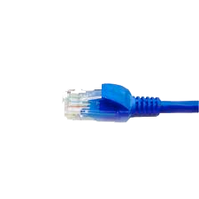

application
(www browser,
email client)
packet
analyzer
application
OS
packet
capture
(pcap)
Transport (TCP/UDP)
Network (IP)
Link (Ethernet)
Physical
copy of all Ethernet frames sent/received

